Slide 1
ROCKBUSTER STEALTH LLC
Rental Data Analysis

Slide 2
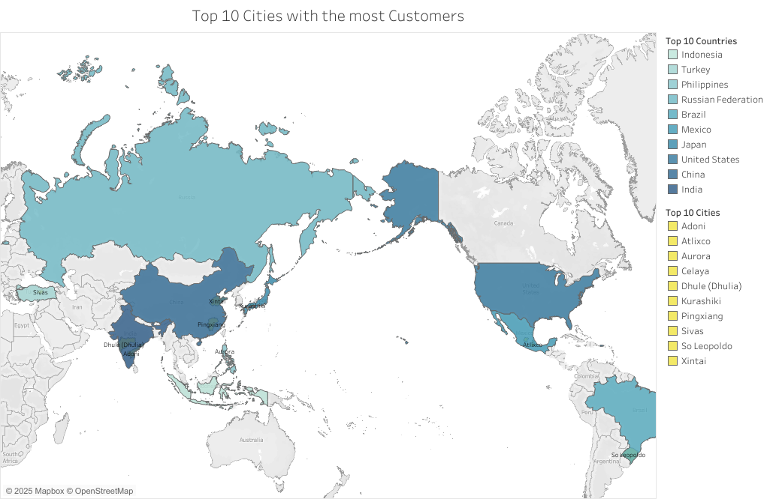
Country | Total Revenue
India | $ 6,034.78
China | $ 5,251.03
United States | $ 3,685.31
Japan | $ 3,122.51
Mexico | $ 2,984.82
Brazil | $ 2,919.19
Russian Federation | $ 2,765.62
Philippines | $ 2,219.70
Turkey | $ 1,498.49
Indonesia | $ 1,352.69
This map depicts Rockbuster’s top ten countries. Within them, the cities of our top customers are highlighted. These countries also generate the top 0.09% of the company’s revenue as shown above. Below, we have the top/least earning rentals.
Title | Total Revenue
Telegraph Voyage | 215.75
Oklahoma Jumanji | 5.94

Slide 3
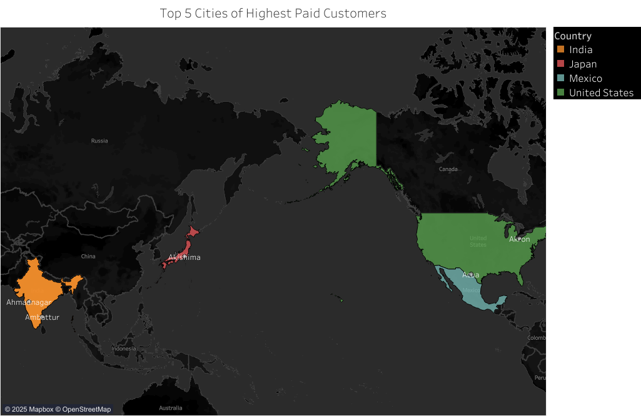
Country | Total Spent
Runion | $ 211.55
United States | $ 208.58
Brazil | $ 194.61
Netherlands | $ 191.62
Belarus | $ 189.60
Iran | $ 183.63
United States | $ 167.67
Canada | $ 167.62
Philippines | $ 166.61
India | $ 162.67
Highlighted to the left are the countries for our top five customers. The cities in which they reside are pinpointed in their respective country.
Above shows where customers with high lifetime value are based.

Slide 4
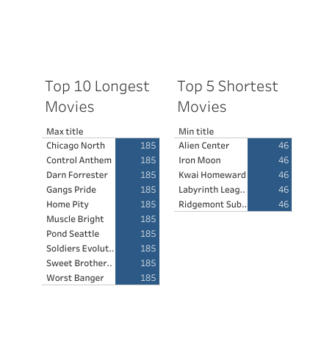
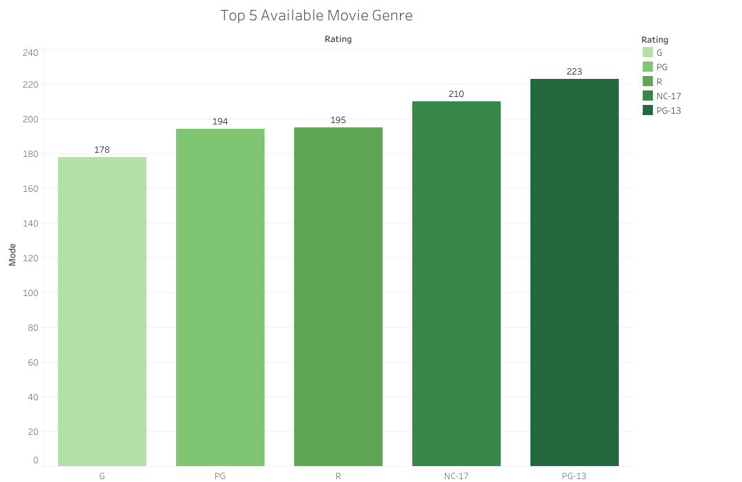
These are the max/min duration of 0.995-0.99% of the movies available. The average duration is that of 115.272 minutes.

Slide 5
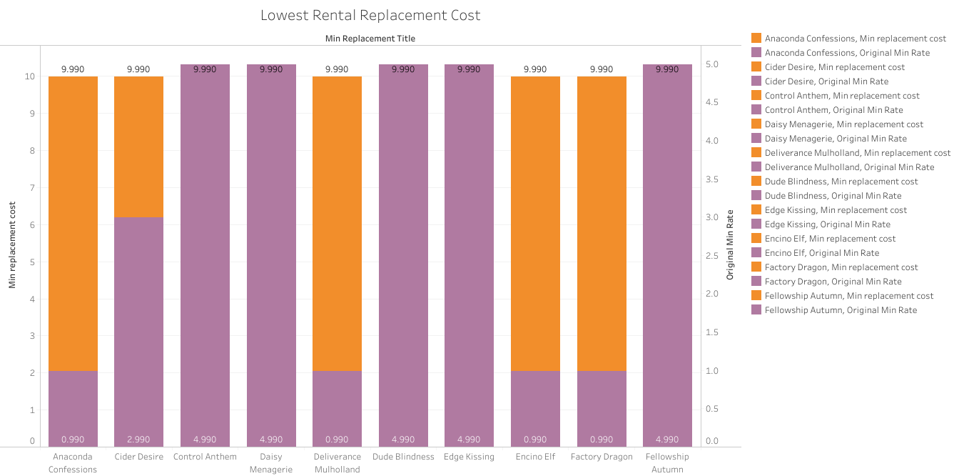
This bar chart visualize the difference in price when rentals are replaced. The lowest replacement cost is a running $9.99 which is measured on the left axis. On the right axis, the rate for the original cost are shown.

Slide 6
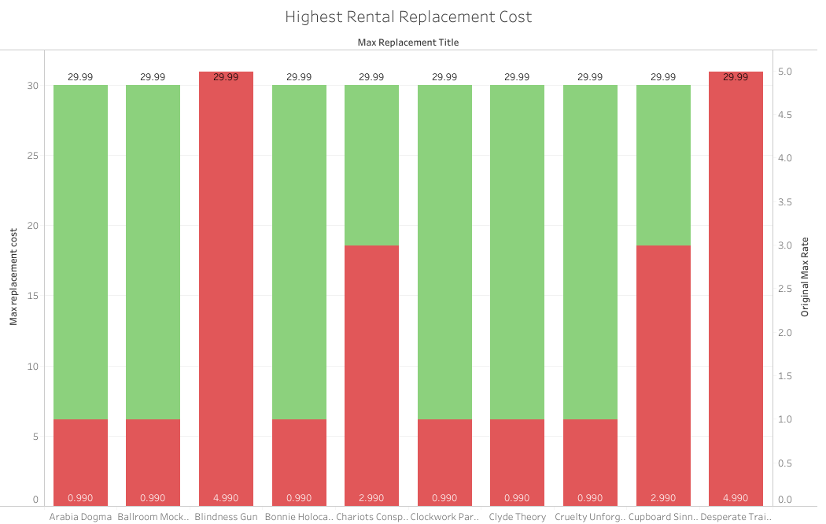
This bar chart visualizes the difference in price when rentals are replaced. The highest replacement cost is a running $29.99 which is measured on the left axis. On the right axis, the rate for the original cost are shown.

Slide 7
Summary
60% of the top ten countries are in Asia.
Asia brings in the most revenue.
To benefit in sales, it would be recommended to add more films translated in Asian languages.
3.6 Visual | Tableau Public/City Vis | Tableau Public

